Slide 1
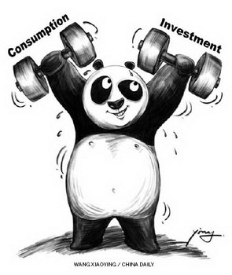
Consumption and Investment

Slide 2
WHAT IS CONSUMPTION?
Consumption “Consumption is the sole end and purpose of all production.” Adam Smith
Consumption is the act of spending income for buying goods and services to satisfy wants.
Determinants of consumption are disposable income of the consumers, their accumulated wealth or assets, their expected future income, the actual price level, the expected general price level, rate of interest, thriftiness, their age, sex and family size etc.

Slide 3
TYPES OF CONSUMPTION
Direct or Final consumption: when the goods satisfy human wants directly and immediately. E.g. taking of meals, use of furniture etc.
Indirect or Productive consumption when the goods are not meant for final consumption but for producing other goods which will satisfy human wants, e.g. use of fertilizer in agriculture etc

Slide 4
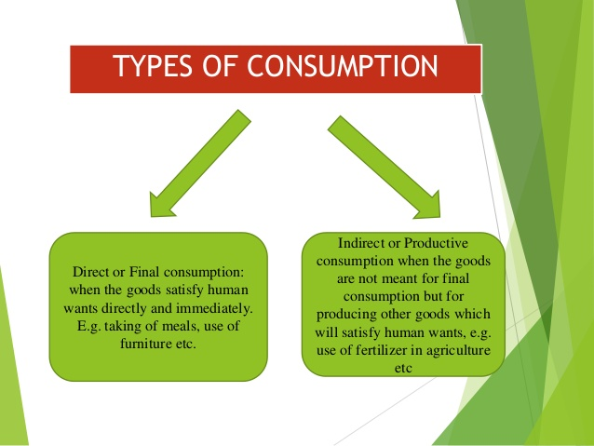

Slide 5
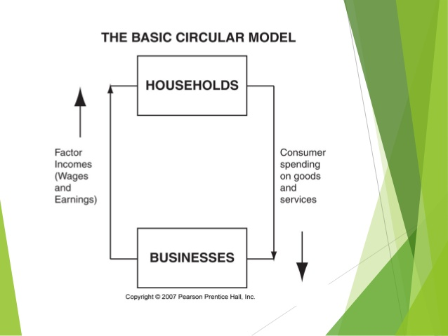

Slide 6
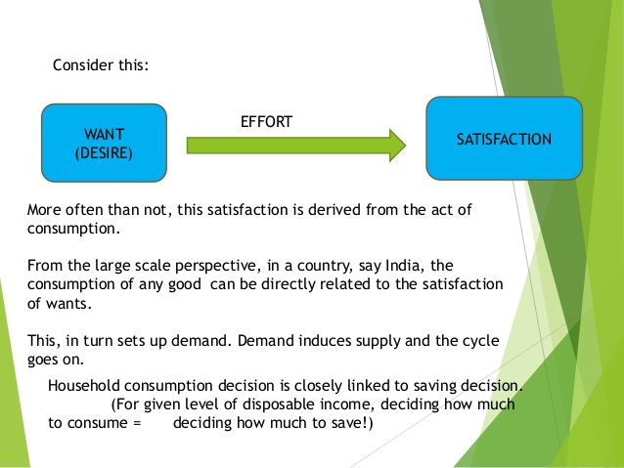
WHY IS CONSUMPTION IMPORTANT?

Slide 7
THE CONSUMPTION FUNCTION
A relation between consumption and its various determinants is called the consumption function.
It is the relationship between consumer spending and the various factors determining it.
At the household or family level, these factors may include income, wealth, expectations about the level and riskiness of future income or wealth, interest rates, age, education, and family size.
It is also influenced by the consumer’s preferences (e.g., patience, or the willingness to delay gratification).

Slide 8
Keynesian Consumption function
Keynes, however, asserts that income alone is the most important determinant of consumption. Here, income refers to the disposable income. The Keynesian consumption function, thus, can be written as:
C=f (Yd), 1>f>0
Where, C=Consumption demand
Yd = Disposable income= (Y-T)
  Y=Personal income
  T=Taxes (related to income)

Slide 9
Keynesian Consumption function
The assumption of the Keynesian consumption function is that consumption depends on income, other things being equal.
The higher the income, higher is the consumption, ceteris paribus.

Slide 10
Keynes’ psychological law of consumption
(The concept of the marginal propensity to consume (MPC)).
Keynes argue that when the income increases, consumption also increases but not to the same extent as the increase in income.

Slide 11
Keynesian Psychological Law “The fundamental psychological law, upon which we are entitled to depend with great confidence both a priori from of our knowledge of human nature and from the detailed facts of experience is that men are disposed of, as a rule and on the average, to increase their consumption as their income increases, but not by as much as the increase in their income.”

Slide 12
The idea is that when the income increases, consumption also increases but less than proportionately.
Alternatively, marginal propensity to consume (MPC) is positive but less than unity (0<MPC<1).

Slide 13
Marginal Propensity to Consume (MPC)
Keynesian Psychological Law is also called the MPC.
Given the consumption function: C= f (Yd), the MPC is the ratio between change in consumption expenditure and the change in income level.
MPC = ∆C = Change in consumption
(∆Yd) Change in disposable income
i.e. 0< =∆C <1

Slide 14
EG. Suppose, initial income level is Rs. 1000 and consumption is Rs. 800.
When income level increases to Rs. 1500, and consumption to Rs. 1200,
MPC will be: =∆C/ ∆Yd =400/500=0.80

Slide 15
This implies that when income increases by Rs. 1, consumption demand increases by 80%. And the difference 20% is the saving.
This means Yd = C + S
i.e. Disposable income = Consumption + Saving

Slide 16
Short run Keynesian consumption function is often written as:
C = Ca + bYd
Ca is autonomous consumption function. This implies that Ca is not related to income level (Yd) since a minimum level of consumption is required just for survival even if there is no income.
And “b” is MPC.
Notes:
What is short run vs long run?
"The short run is a period of time in which the quantity of at least one input is fixed and the quantities of the other inputs can be varied. The long run is a period of time in which the quantities of all inputs can be varied.

Slide 17
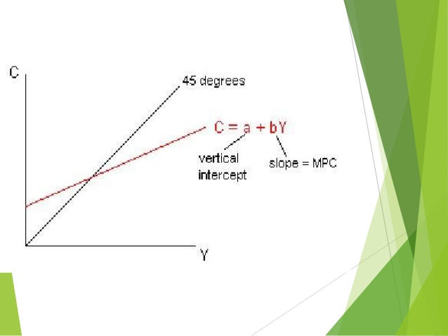

Slide 18
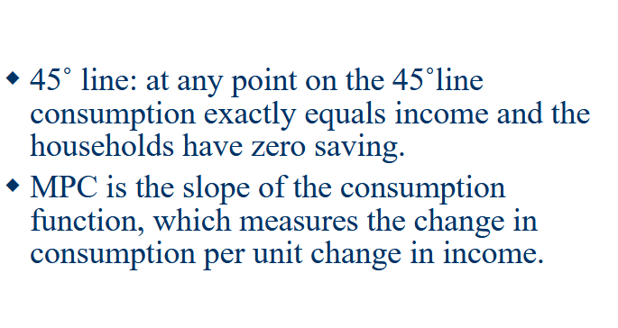

Slide 19
Eg.
Ca= 175, b=0.75
Now, the function becomes: C= 175+ 0.75*Yd
For a given value of disposable income, we can calculate the consumption expenditure.

Slide 20
Example of Short Run vs. Long Run
Consider the example of a hockey stick manufacturer. A company in that industry will need the following to manufacture its sticks:
Raw materials
Labor
Machinery
A factory

Slide 21
Variable Inputs and Fixed Inputs
Suppose the demand for hockey sticks has greatly increased, prompting the company to produce more sticks. It should be able to order more raw materials with little delay, so consider raw materials to be a variable input.
Additional labor will be needed, but that could come from an extra shift and overtime, so this is also a variable input.

Slide 22
Equipment, on the other hand, might not be a variable input. It might be time-consuming to add equipment.
Adding an extra factory, on the other hand, is certainly not something that could be done in a short period of time, so this would be the fixed input.

Slide 23
Using the definitions at the beginning of the article, the short run is the period in which a company can increase production by adding more raw materials and more labor but not another factory.
Conversely, the long run is the period in which all inputs are variable, including factory space, meaning that there are no fixed factors or constraints preventing an increase in production output.

Slide 24
Short run and long run consumption
The short run consumption is non- proportional in the sense that consumption is partly autonomous and partly induced that is related to the current disposable income.
The long run consumption fully depends on income. The long run autonomous consumption is zero and according to Keynes, in the long run, we all die if fail to generate our own income.

Slide 25
SAVINGS
Definition
Savings are the amount left over when the cost of a person's consumer expenditure is subtracted from the amount of disposable income that he or she earns in a given period of time.

Slide 26
WHAT IS SAVINGS?
To economists, saving means not consuming from a fixed amount of resources to enable higher consumption in the future.
It is the decision to defer consumption and to store this deferred consumption in some form of asset.

Slide 27
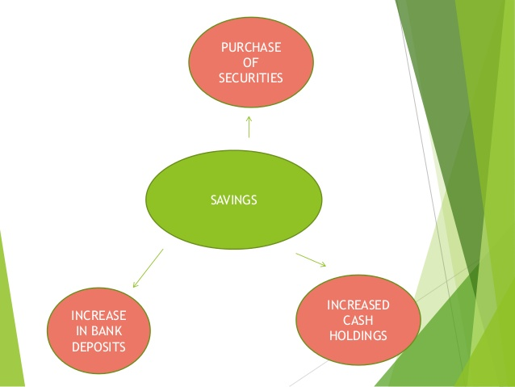

Slide 28
The extent to which consumers save is affected by their preference for the future over present consumption, expectations of future income and rate of interest.

Slide 29
People save—accumulate assets—to finance their retirement, and they dissave—spend their assets—during retirement.
The precautionary motive—that is, the motive to save in order to be prepared for various future risks—is one of the key reasons people save. WHY DO PEOPLE SAVE?

Slide 30
By saving we can invest money to produce fixed capital, which contributes to economic growth.
However, savings do not always correspond to increased investment. If the money is not deposited into a financial intermediary, it is not recycled in investment.
This can cause a shortfall of demand and recession instead of economic growth.

Slide 31
Saving Function
The part of the disposable income not spent on consumption is called saving. In this case, saving is the difference between disposable income and consumption.

Slide 32
It is based on the premise that Yd=C+S
  Then S=Yd-C
S=Yd- (Ca+bYd)
Or, S= -Ca+(1-b)Yd
Where,
-Ca=Autonomous saving that is negative or that is dissaving. A person must borrow in order to survive.
1-b is marginal propensity to save as we know b is marginal propensity to consume.

Slide 33
Marginal Propensity to save
MPS is the change in saving as a result of an additional unit of disposable income.
MPS = ∆S = Change in saving
∆Yd Change in disposable income
Since MPC+MPS=1, when MPC increases, MPS decreases.

Slide 34
Why are MPC and MPS related like mirror images?
Disposable income = Consumption + Saving
This implies that each extra rupee of disposable income must be divided between extra consumption and extra saving.
Thus is MPC is 0.85, then MPS must be 0.15.
MPC and MPS must always add up to exactly 1, no more or no less. Everywhere and always MPS = 1 - MPC

Slide 35
THE INVESTMENT FUNCTION
Investment is the expenditure on capital goods made for the purpose of income regeneration.
In other words, an investment is the purchase of goods that is not used today but is used in the future to create wealth or income.
The building of a factory used to produce goods and the investment one makes by going to college or university are both examples of investments in the economic sense.

Slide 36
Investment plays two roles in macroeconomics:
Because it is large and volatile component of spending, investment often leads to changes in aggregate demand and affects the business cycle.
Investment often leads to capital accumulation. Adding to the stock of buildings and equipment increases the nation’s potential output and promotes growth in the long run.

Slide 37
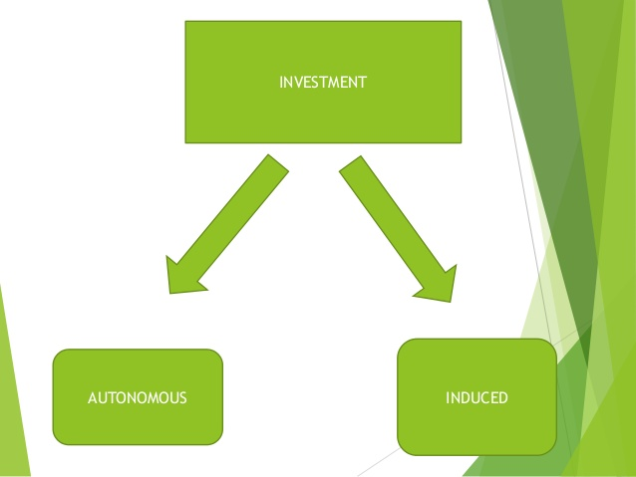

Slide 38
AUTONOMOUS INVESTMENT
Expenditure made that is independent of economic growth.
They are investments made for the good of society and not for the goal of making profits
For example: The Government invests on infrastructure items, such as roads and highways, and other investments that keep the economic engine running.

Slide 39
INDUCED INVESTMENT
Investment which changes with the changes in the income level, is called as Induced Investment.
Induced Investment is positively related to the income level. That is, at high levels of income entrepreneurs are induced to invest more and vice-versa.
At a high level of income, Consumption expenditure increases this leads to an increase in investment of capital goods, in order to produce more consumer goods.

Slide 40
